Slide 1

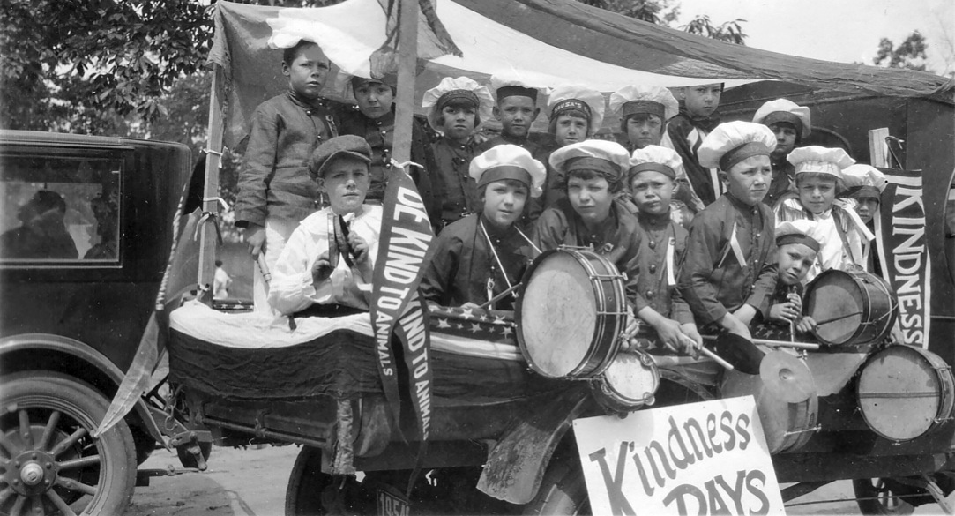


Slide 2
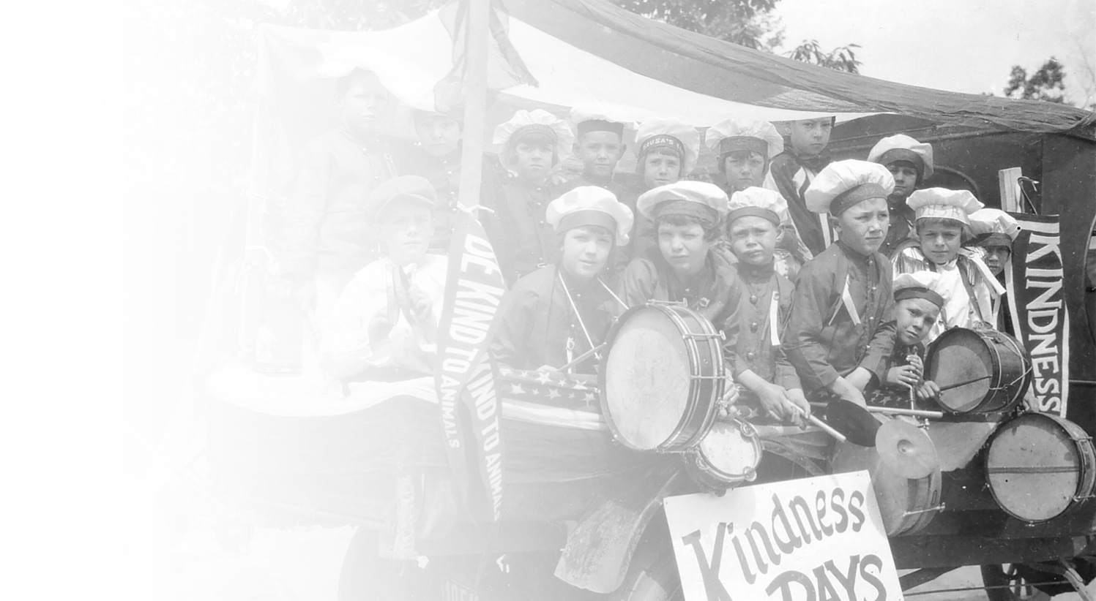
In 1915, American Humane Association pioneered what would become the longest-running, most successful humane education initiative in U.S. history…
BE KIND TO ANIMALS WEEK taught generations of Americans the value of treating all the world’s creatures with kindness and care…
Through two World Wars, the Great Depression, and countless challenges, Be Kind to Animals Week stood as a beacon of humanity and compassion...celebrated by adults, schoolchildren, and communities across the country...
100 years later, let’s look back at the remarkable, poignant, humorous, and inspiring moments and leaders who have helped to make a more humane world.

Slide 3

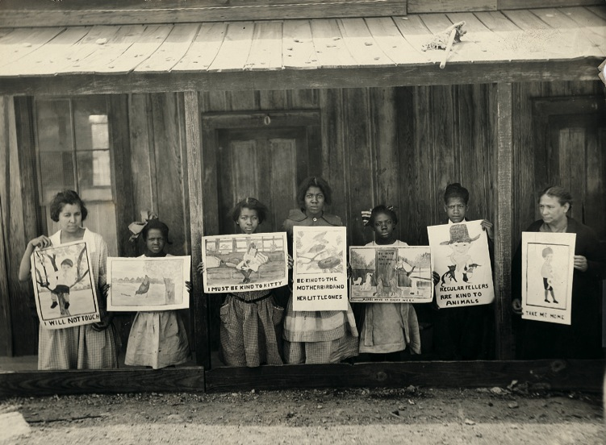
﻿1915:
The inaugural “Humane Sunday” and “Be Kind to Animals Week” are observed by humane groups across America from May 16-22. Though the sinking of the RMS Lusitania just several days before was fresh on everyone’s mind, the celebration went ahead as scheduled. American Humane Association president Dr. William O. Stillman reported that “the humane movement never received as much general publicity in the same length of time as during the few weeks before and including ‘Be Kind to Animals Week’ and ‘Humane Sunday.’”

Slide 4

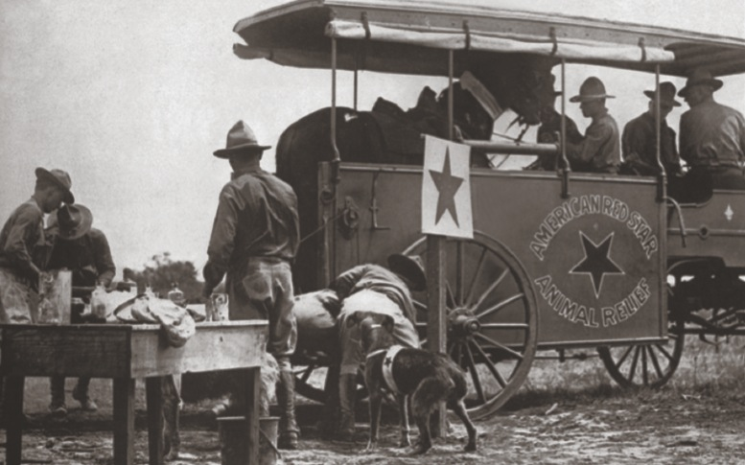
﻿1916:
﻿One day after the conclusion of the second-ever “Be Kind to Animals Week,” American Humane Association president Dr. William
O. Stillman receives a letter from U.S. Secretary of War Newton D. Baker asking American Humane Association to send a team to Europe to care for the sick and wounded animals used in battle, just as the Red Cross had been asked to do for humans. American Humane Association’s Red Star® Rescue team thus began its first assignment, rescuing and helping 68,000 wounded horses each month. Since the end of World War I Red Star has continued to care for animals in need caught in the path of both natural and manmade disasters.

Slide 5
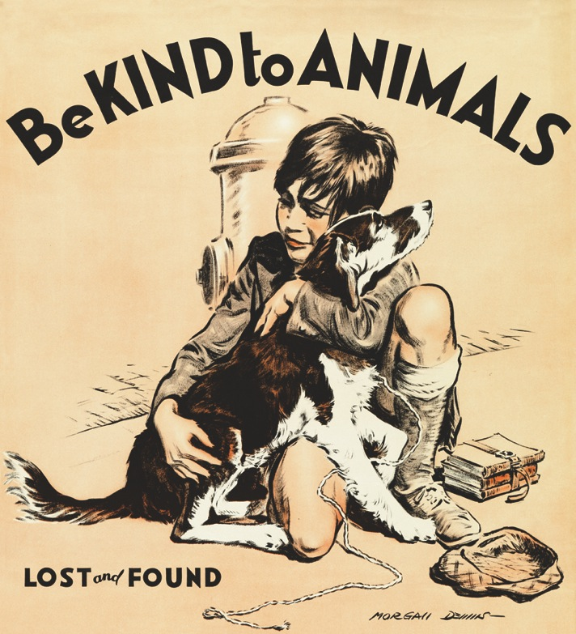
﻿1922:
﻿U.S. President Warren G. Harding issues an official proclamation on “Be Kind to Animals Week.” One of the major themes this year is the commemoration of the centennial for the passage of the “Martin Bill,” England’s first national animal protection act.
﻿1927:
Popular poet Edgar Guest pens a poem entitled
“On Kindness to Animals,” which contains the verse:
They cannot ask for kindness
Nor for our mercy plead,
Yet cruel is our blindness
Which does not see their need.

Slide 6
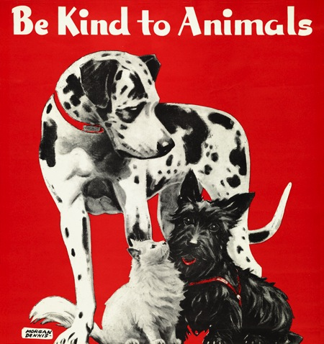
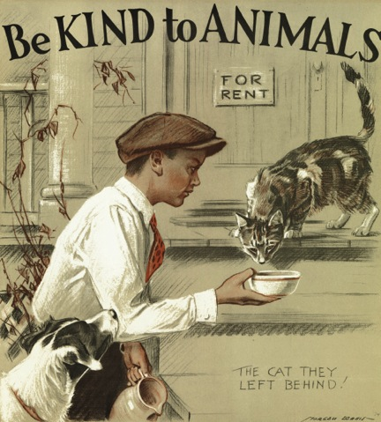
﻿1931:
﻿American Humane Association reports that 52,000 “Be Kind to Animals Week” posters
were ordered for that year’s festivities, double the number over the year before and by far
the most to date. Word of the new campaign continues to spread across the country.
﻿1932:
Morgan Dennis, the artist most famously tied
To “Be Kind to Animals Week,” unveils the first
of many posters for the week. Each year, his poster is a powerful visual representation of a person – usually a child – displaying an act of kindness toward an animal in need. His
period-specific details – from the fashions worn to even the model years of the cars – create
a timeless snapshot of each particular year.

Slide 7
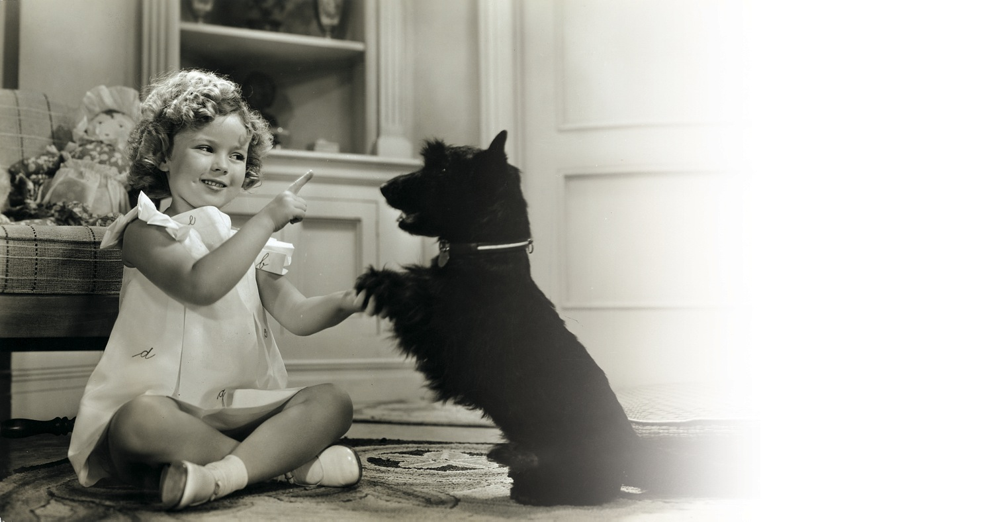
﻿﻿1936:
﻿﻿Shirley Temple, the biggest child star of her era, serves as junior chair for “Be Kind to Animals Week.” Though she herself is too young to drive, she urges motorists to be vigilant to avoid animals crossing the roadway. Temple appears twice on the cover of National Humane Review, American Humane Association’s monthly publication, in June 1935 and January 1936, and her participation prompts national coverage.
﻿

Slide 8

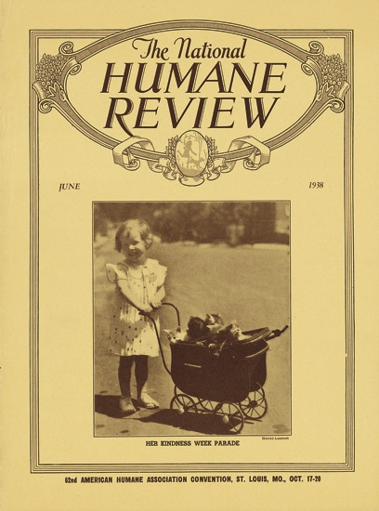
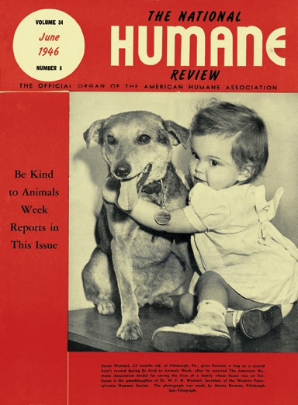
﻿1943:
﻿﻿First Lady Eleanor Roosevelt writes about “Be Kind to Animals Week” in the
April 13th edition of her syndicated newspaper column, “My Day.” With the nation deeply embroiled in World War II, she writes: “Though it may seem to a good many people that a time when the world is hardly a kind world is not a time to emphasize kindness to animals, and that we should think primarily of our attitude toward human beings, I believe there is great value in continuing to train children in the proper attitude toward their pets.” She would cite the importance of this special week in her column virtually every year during this tumultuous decade.
﻿

Slide 9
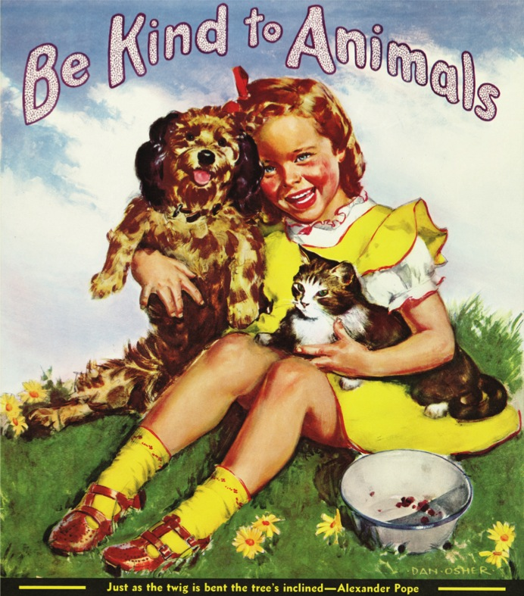
﻿1949:
﻿﻿“Be Kind to Animals Week” is prominently featured on the cover and throughout an issue of the “Casper the Friendly Ghost” comic book. Tom, the mouse nemesis to cat Jerry of the “Tom and Jerry” cartoon shorts, resolves for once to be kind to his feline counterpart during a special “Be Kind to Animals Week” edition of their show.
﻿
1950:
﻿Porky Pig learns an important lesson of compassion on a special “Be Kind to Animals Week”-themed “Looney Tunes” short entitled “Dog Collared,” where he eventually befriends and adopts a dog who follows him everywhere.

Slide 10
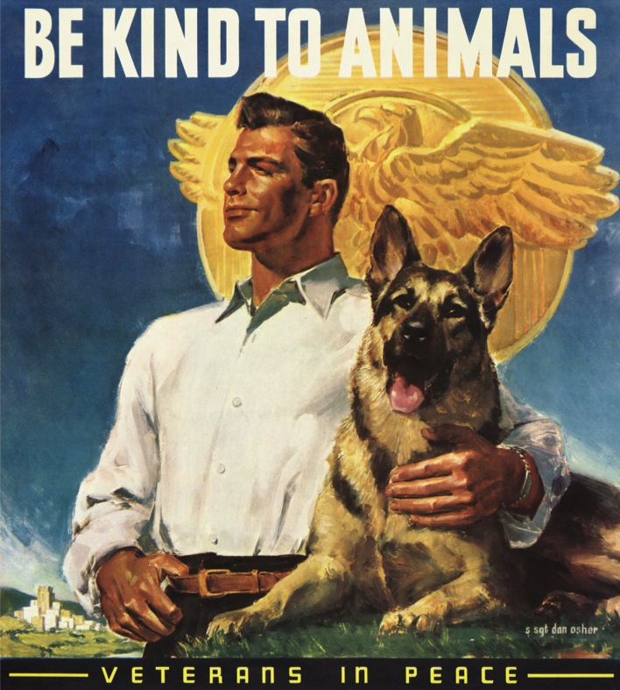
﻿1952:
﻿﻿﻿Noted author Fannie Hurst promotes “Be Kind to Animals Week” activities on a nationwide broadcast on CBS Radio heard by millions of Americans.﻿
1959:
﻿﻿On Sunday May 3, the nationally syndicated comic strip “Dennis the Menace” features a “Be Kind to Animals Week” theme, reaching out to children and adults alike with the importance of treating all animals with compassion.

Slide 11
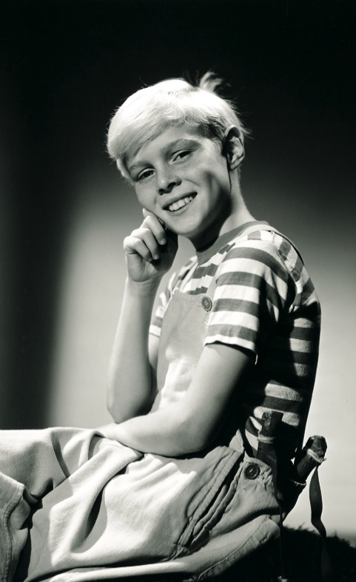
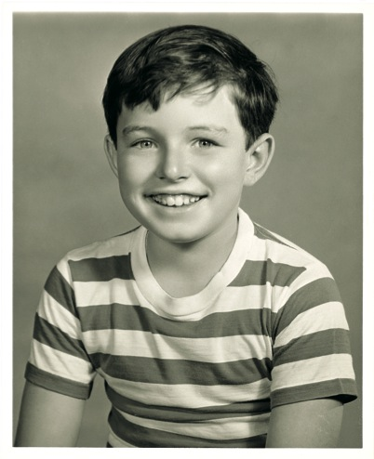
﻿1960:
﻿﻿﻿Following the lead of his comic strip character, child actor Jay North, the
star of the sitcom “Dennis the Menace,” serves as spokesperson for the year’s celebration; he is joined by fellow CBS
child star Jerry Mathers, better known
as Beaver Cleaver on “Leave it to Beaver.”
﻿
﻿1962:
﻿﻿﻿American Humane Association distributes more than 70,000 pieces of literature related to that year’s celebration. An editorial in the National Humane Review explains that “the idea really caught on. Across the country, humane societies and interested individuals campaigned for kindness.”

Slide 12
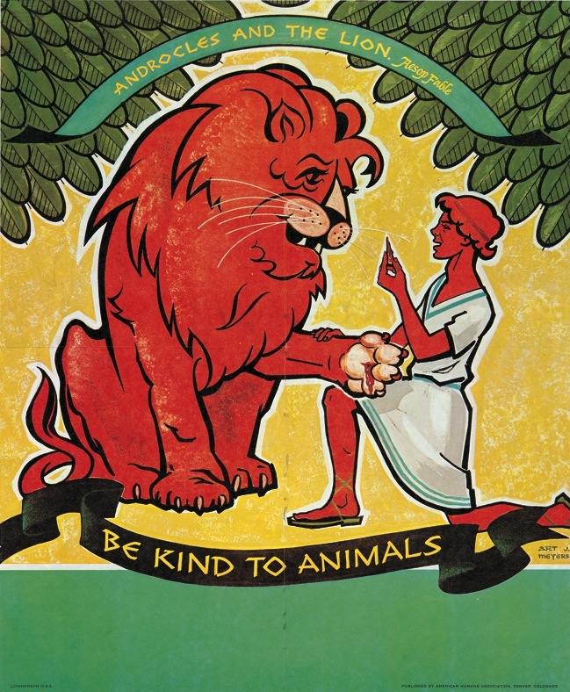
﻿1966:
﻿﻿﻿﻿“Bonanza” star Lorne Greene joins the cause, urging Americans to keep a watchful eye on their animals as dognapping and cattle rustling are still seen as widespread issues of the day.
1969:
﻿﻿﻿For the Golden Anniversary of “Be Kind to Animals Week,” Jon Provost, known by all the world as little “Timmy” from the hit television series, “Lassie,” is chairman; he is joined by a host of other honorary chairs from major TV shows, including Patty Duke.

Slide 13
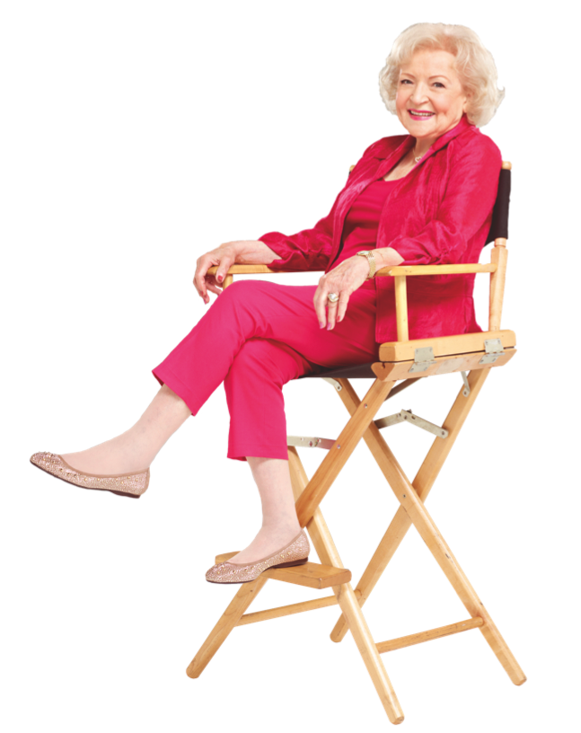
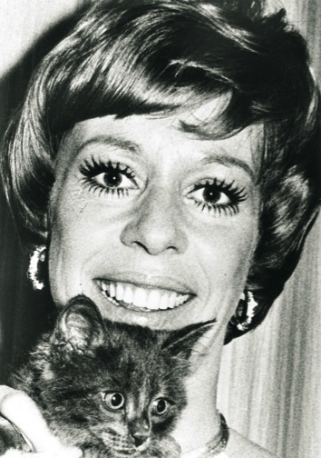
﻿1971:
﻿﻿﻿﻿Betty White is appointed “National Kindness Chairman,” beginning her decades-long legacy of working with American Humane Association, which endures to this day.
1972:
﻿﻿﻿Comedy legend Carol Burnett is named “National Kindness Chairman” and helps to spread important tips for first-time
pet adopters and for children on
how to care for their new furry friends.

Slide 14

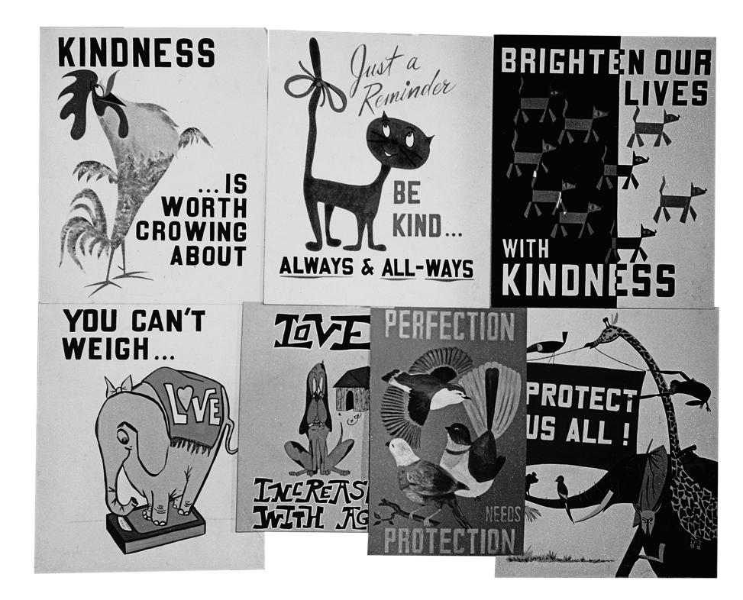

Slide 15
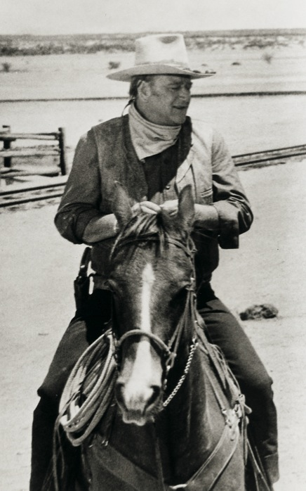
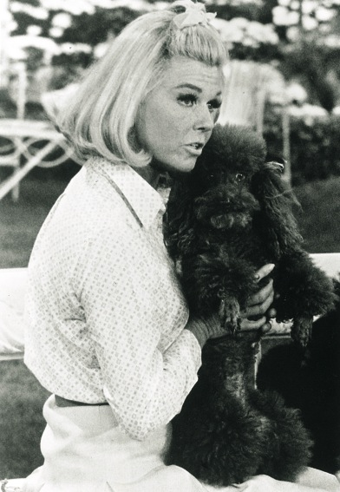
﻿1973:
﻿﻿﻿﻿Iconic movie cowboy John Wayne lends his voice as chair of the year’s celebration. Popular television show “Romper Room” promotes “Be Kind to Animals Week” to its millions of tiny viewers.
﻿1975:
﻿﻿﻿﻿Doris Day, the year’s “National Kindness Chairman,” says that the most important criterion for owning a pet is “to be a responsible pet owner.” Some 1,200 humane organizations across the country celebrate “Be Kind to Animals Week.” American Humane Association begins a campaign to have “Be Kind to Animals Week” officially recognized by the United States Congress, which would take more than a decade to happen.

Slide 16
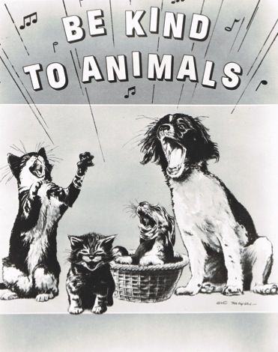
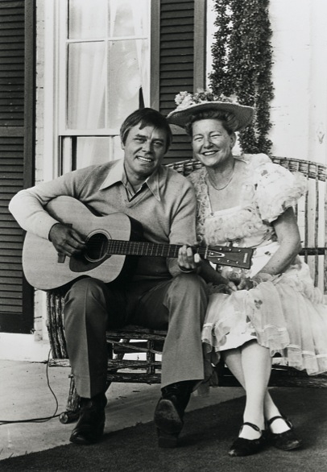
﻿1977:
﻿﻿﻿﻿﻿American Humane Association celebrates its centennial. The year’s co-chairs, country-western singers Tom T. Hall and Minnie Pearl, fit in perfectly with the year’s theme of “Americana.” American Humane Association writes in its annual campaign toolkit that “country-western entertainment is a totally American phenomenon developed at a grassroots level in the 19th century and subsequently spread to become an international rage, just as how much of American Humane’s work through the early years was also launched at limited local levels, eventually catching the public’s imagination.”

Slide 17
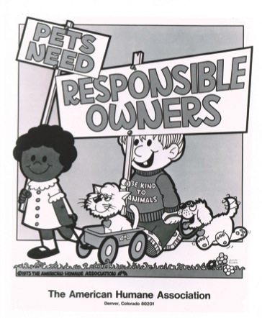
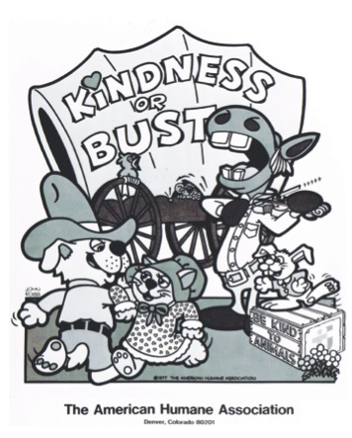

﻿1982:
﻿﻿﻿﻿﻿﻿Hollywood superstar director and actor and lifelong animal lover Clint Eastwood serves as “National Kindness Chair.” Eastwood, who has worked with many animals on set throughout his career, is eager to lend his name because of his support of American Humane Association’s “No Animals Were Harmed®” program, which has protected animal actors on set since 1940. “I won’t allow a scene where animals are mistreated. I won’t tolerate it and never have. There’s no movie that’s worth it. I’ve loved animals all my life, and I’ve brought up my kids the same way, to respect every kind of living creature,” he says.

Slide 18
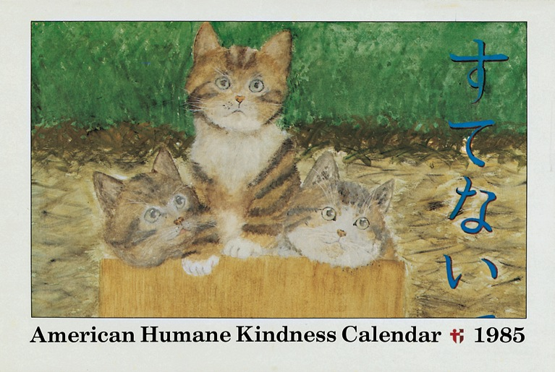
﻿1985:
﻿﻿﻿﻿﻿﻿﻿Bruce Boxleitner, star of television’s “Scarecrow and Mrs. King” and the movie Tron, is named the chairperson that year. Boxleitner grew up on an Illinois dairy farm and at the time lived on a ranch north of Hollywood with his horses. “Living a rancher’s life teaches [my son] Sam responsibility towards all living creatures,” he says. Nearly 30 years later he would again support American Humane Association
by presenting an award at the 2014 American Humane Association Hero Dog Awards™.

Slide 19
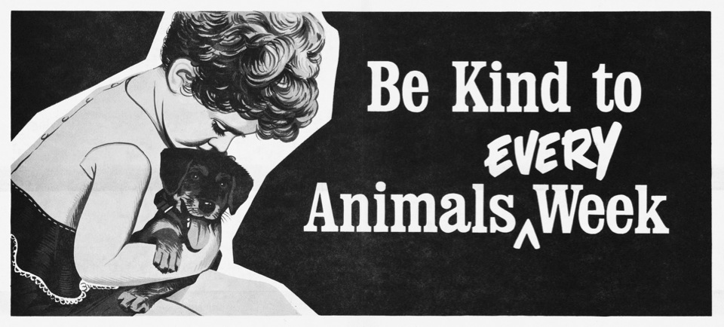
﻿1990:
﻿﻿﻿﻿﻿﻿﻿﻿Just in time for its 75th anniversary, the 101st Congress passes a resolution officially recognizing the first full week of May every year as “Be Kind to Animals Week.” The bill, introduced by Senator Pete Wilson of California, states that “The people of the United States are indebted to animal protection organizations, state humane organizations, and local animal care and control agencies for promoting respect for animals and pets, educating children about humane attitudes, and caring for lost, unwanted, abused, and abandoned animals.”

Slide 20
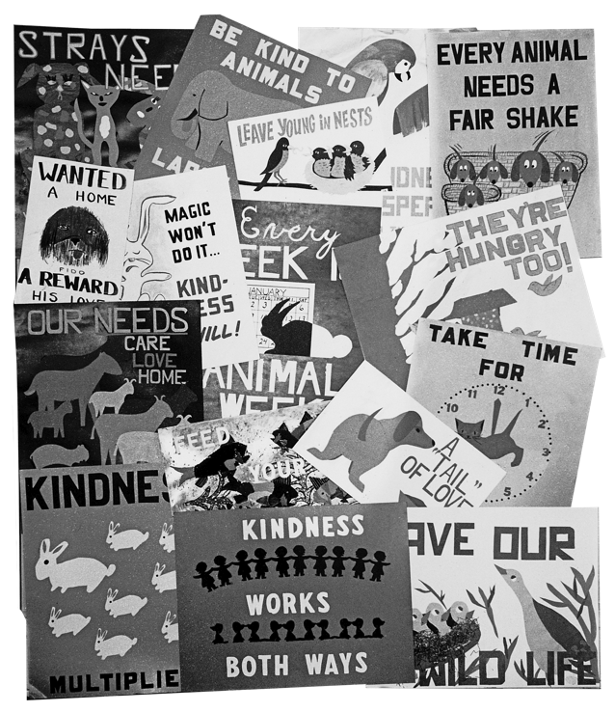
﻿1993:
﻿﻿﻿﻿﻿﻿﻿﻿Newly inaugurated President Bill Clinton issues a proclamation on the occasion of the year’s “Be Kind to Animals Week,” stating “We celebrate this week in order to remember the many ways that animals help us. By serving as guides, animals aid the blind. As lookouts and detectives, animals assist in our military, customs, and law enforcement efforts. As friends and companions, pets befriend our children, ease the loneliness of the elderly and the ill, and entertain our families in our daily lives. We also salute the veterinary professionals and animal protection organizations that help us provide food, shelter, and medical care for animals and pets.”

Slide 21
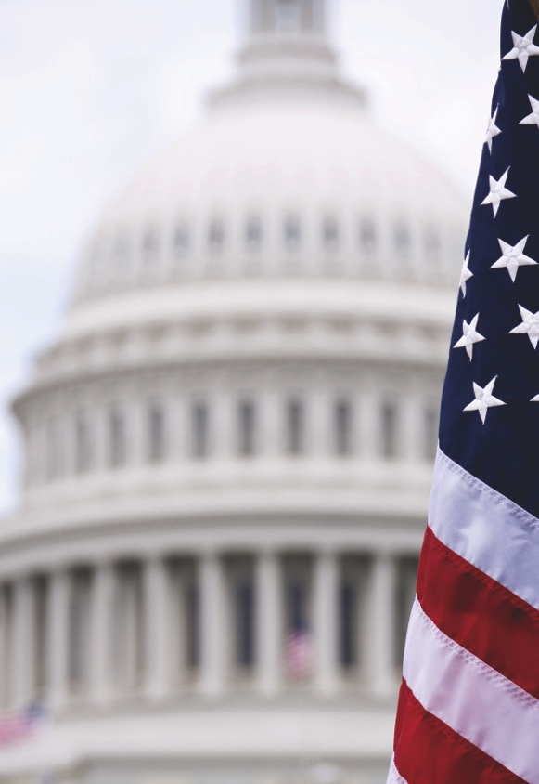
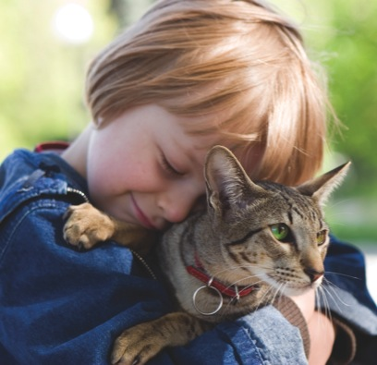
﻿1995:
﻿﻿﻿﻿﻿﻿﻿﻿﻿American Humane Association holds a national press conference commemorating the 80th year of “Be Kind to Animals Week,” and urges Congress to pass legislation allowing for residents in all federally subsidized housing to be able to have pets.
2000:
﻿﻿﻿﻿﻿﻿﻿﻿﻿﻿Allie Pearlman, a 12-year old from Old Bethpage,
New York, is named the year’s “BKA Kid Contest” winner and receives a $10,000 scholarship from American Humane Association. The fifth grader was a compassionate crusader for ending the process of live frog dissection at her school. As a result of her efforts, her school district purchases a computer program to simulate frog dissection instead of using live animals.

Slide 22
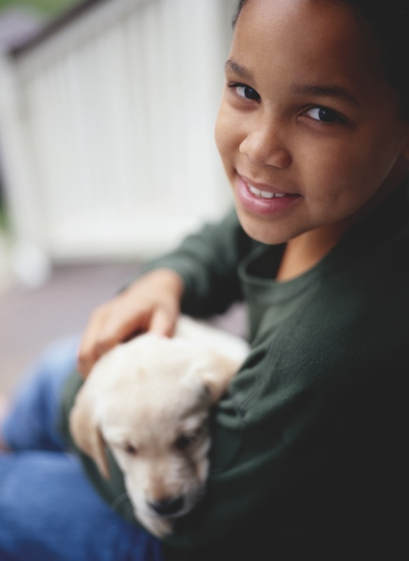
﻿2005:
﻿﻿﻿﻿﻿﻿﻿﻿﻿﻿Ninety years after the very first “Be Kind to Animals Week,” American Humane Association announces two co-winners of its annual “Kindness Kid” contest:
Bagley Knox, who spent many hours volunteering at her local animal shelter, encouraged her Girl Scout troop to donate a portion of cookie sale proceeds to the shelter, and even gave up birthday gifts so her friends would donate supplies and food to the shelter that year; and Michael Valdez, who raised more than $70,000 to outfit as many police dogs as possible in his home state of Arizona with special stab- and bulletproof vests. Each winner received a $5,000 college scholarship.

Slide 23
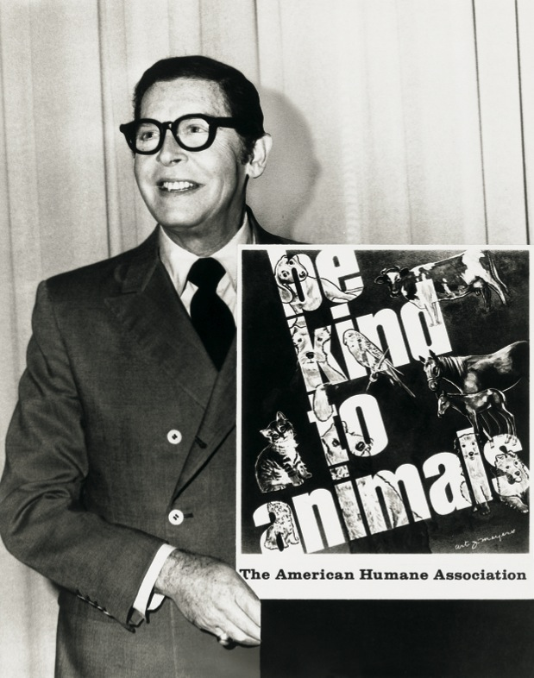
﻿2015:
﻿﻿﻿﻿﻿﻿﻿﻿﻿﻿American Humane Association celebrates a century of “Be Kind to Animals Week” with a year-long national campaign and traveling exhibition tour to enlist millions of schoolchildren (and adults) in a new Compassion Movement to address the remaining challenges facing the world’s creatures.
*Many other celebrities have served as official spokespeople for “Be Kind to Animals Week” over the years, including Milton Berle (1970), Shirley Jones (1974), Dan Haggerty (1978), Norm Crosby (1980), Joan Van Ark (1983), Robert Wagner (1984), and Richard Dreyfuss (1991).

Slide 24
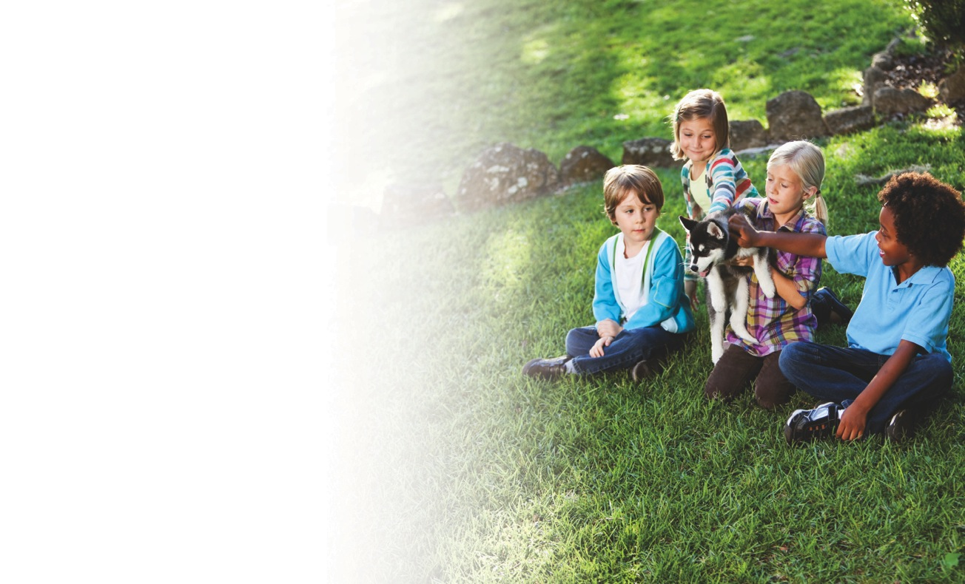
﻿﻿﻿Now, on the 100th anniversary of Be Kind to Animals Week, join us in
a new Compassion Movement to address the remaining challenges to animals everywhere…
Go to Kindness100.org and take the Humane Pledge to:
Improve the lives of 10 billion U.S. farm animals each year by choosing humanely raised products
Protect 100,000 animals in film and television each year insisting
productions carry the “No Animals Were Harmed®” end-credit
Save more of the 6-8 million animals who end up in shelters each year by adopting your pet from a shelter
Teach children the beauty and value of the world’s endangered and disappearing creatures by taking them to aquariums, zoos, parks, and conservation centers where the preservation and rehabilitation of wildlife is providing a lifeboat for these beautiful animals
Thank you!
www.Kindness100.org #Kindness100

